Slide 1


Predict house prices
Harrison Lucas

Slide 2


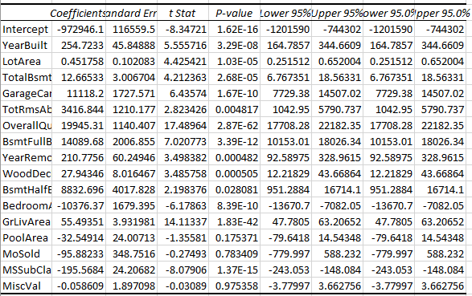
What did you build and how does it work?
I made a multiple regression using 16 factors I thought impacted the price of a house the most.

Slide 3
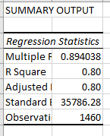
What is the purpose and objective of your dashboard?
The purpose of this regression was to make a model that could predict the prices of houses based on a variety of variable with at least a at least an .80 r squared

Slide 4
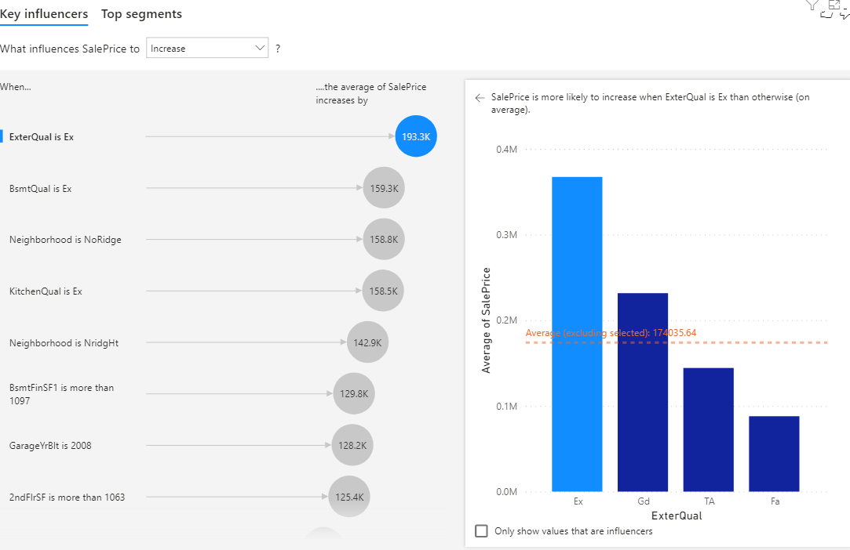
What does this solution teach us about your data source?
This solution shows me what factors I can expect to have an influence on housing prices.

